Slide 1
SLEEP & WAKEUP
Session 14
In this session, we will understand and explore the design of sleep and wakeup algorithms

Slide 2
Synchronization

Slide 3

Program 0
Program 1
a1 count = count + 1
b1 count = count - 1
count
allocated
use
acquire
P0
P1

Slide 4

Motivating Scenario
shared variable
program 0
int counter=5;
program 1
{
*
* counter++
*
}
{
*
*
counter--
*
}
•
Single core
– Program 1 and program 2 are executing at the same time but sharing a single core
1
2
1
2
1
2
1 2
CPU usage wrt time

Slide 5
Motivating Scenario
Shared variable
program 0
int counter=5;
program 1
{
*
* counter++
*
}
{
*
* counter--
*
}
What is the value of counter?
expected to be 5
but could also be 4 and 6

Slide 6
Motivating Scenario
Shared variable
program 0
int counter=5;
program 1
{
*
*
counter++
*
}
{
*
* counter--
*
}
 | R1 ⇓ counter R1 ⇓ R1 + 1 counter ⇓R1
 | R2 ⇓ counter R2 ⇓ R2 - 1 counter ⇓R2
 | R1 ⇓ counter
 | R2 ⇓ counter R2 ⇓R2 - 1 counter ⇓R2
 | R1 ⇓ R1 + 1 counter ⇓ R1
 | R2 ⇓ counter
 | R2 ⇓ counter R2 ⇓R2 + 1 counter ⇓R2
 | R2 ⇓ R2 - 1 counter ⇓ R2
context switch
counter = 5
counter = 6
counter = 4

Slide 7
Race Conditions
•
Race conditions
A situation where several processes access and manipulate the same data (critical section)
The outcome depends on the order in which the access take place
Prevent race conditions by synchronization
Ensure only one process at a time manipulates the critical data
{
*
*
counter++
critical section
*
}
No more than one process should execute in critical section at a time

Slide 8
Critical Section
Requirements
Mutual Exclusion : No more than one process in critical section at a given time
Progress : When no process is in the critical section, any process that requests entry into the critical section must be permitted without any delay
No starvation (bounded wait): There is an upper bound on the number of times a process enters the critical section, while another is waiting.

Slide 9
Locks and Unlocks
shared variable
program 0
int counter=5; lock_t L;
program 1
{
*
* lock(L) counter++ unlock(L)
*
}
{
*
* lock(L) counter-- unlock(L)
*
}
•
lock(L) : acquire lock L exclusively
Only the process with L can access the critical section
unlock(L) : release exclusive access to lock L
Permitting other processes to access the critical section
•

Slide 10
How to Implement Locking

Slide 11
Using Interrupts
Process 1
Process 2
 | while(1){
 |  | disable interrupts () critical section enable interrupts () other code
 | }
while(1){
disable interrupts () critical section enable interrupts () other code
}
lock
unlock
Simple
When interrupts are disabled, context switches won’t happen
Requires privileges
User processes generally cannot disable interrupts
Not suited for multicore systems

Slide 12
Semaphore
Synchronization tool that does not require busy waiting
Semaphore S – integer variable
Two standard operations modify S: wait() and signal()
Originally called P() and V()
Less complicated
Can only be accessed via two indivisible (atomic) operations
wait (S) {
while S <= 0
; // no-op
S--;
}
signal (S) {
S++;
}

Slide 13
Semaphore as General Synchronization Tool
Counting semaphore – integer value can range over an unrestricted domain
Binary semaphore – integer value can range only between 0 and 1; can be simpler to implement
Also known as mutex locks
Can implement a counting semaphore S as a binary semaphore
Provides mutual exclusion
Semaphore S; // initialized to 1
wait (S);
Critical Section
signal (S);

Slide 14
Semaphore Implementation
Must guarantee that no two processes can execute wait () and signal () on the same semaphore at the same time
Thus, implementation becomes the critical section problem where the wait and signal code are placed in the critical section.
Could now have busy waiting in critical section implementation
But implementation code is short
Little busy waiting if critical section rarely occupied
Note that applications may spend lots of time in critical sections and therefore this is not a good solution.

Slide 15
Semaphore Implementation with no Busy waiting
With each semaphore there is an associated waiting queue. Each entry in a waiting queue has two data items:
value (of type integer)
pointer to next record in the list
Two operations:
Sleep/block – place the process invoking the operation on the appropriate waiting queue.
wakeup – remove one of processes in the waiting queue and place it in the ready queue.

Slide 16
Semaphore Implementation with no Busy waiting (Cont.)
Implementation of wait:
wait (S){
value--;
if (value < 0) {
add this process to waiting queue
sleep()/block(); }
}
Implementation of signal:
Signal (S){
value++;
if (value <= 0) {
remove a process P from the waiting queue
wakeup(P); }
}

Slide 17
Deadlock and Starvation
Deadlock – two or more processes are waiting indefinitely for an event that can be caused by only one of the waiting processes
Let S and Q be two semaphores initialized to 1
P₀ P₁
wait (S); wait (Q);
wait (Q); wait (S);
. .
. .
. .
signal (S); signal (Q);
signal (Q); signal (S);
Starvation – indefinite blocking. A process may never be removed from the semaphore queue in which it is suspended.

Slide 18
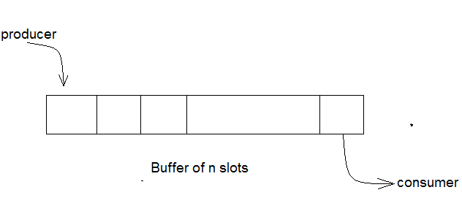
Bounded-Buffer Problem
The structure of the producer process
while (true) {
// produce an item
wait (empty);
wait (mutex);
// add the item to the buffer
signal (mutex);
signal (full);
}
The structure of the consumer process
while (true) {
wait (full);
wait (mutex);
// remove an item from buffer
signal (mutex);
signal (empty);
// consume the removed item
}
N buffers, each can hold one item
Semaphore mutex initialized to the value 1
Semaphore full initialized to the value 0
Semaphore empty initialized to the value N.

Slide 19
Sleep and Wakeup
(Producer Consumer problem)
#define N 100 //maximum slots in buffer
#define count=0 //items in the buffer
void producer (void)
{
int item;
while(True)
{
item = produce_item(); //producer produces an item
if(count == N) //if the buffer is full then the producer will sleep Sleep();
insert_item (item); //the item is inserted into buffer
countcount=count+1;
if(count==1) //The producer will wake up the
//consumer if there is at least 1 item in the buffer
wake-up(consumer);
}
}

Slide 20
void consumer (void)
{
int item;
while(True)
{
{
if(count == 0) //The consumer will sleep if the buffer is empty.sleep();
item = remove_item();
countcount = count - 1;
if(count == N-1) //if there is at least one slot available in the buffer
//then the consumer will wake up producer
wake-up(producer);
consume_item(item); //the item is read by consumer.
}
}
}

Slide 21
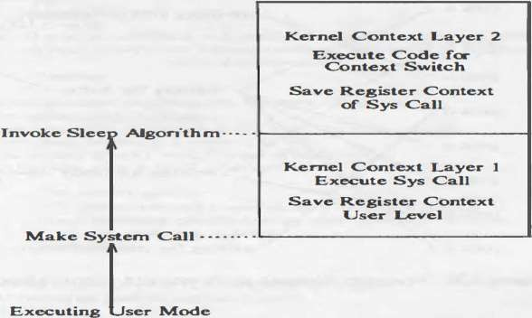
Sleep
The algorithms for sleep, which changes the process state from "kernel running" to "asleep in memory," and wakeup, which changes the process state from "asleep" to "ready to run" in memory or swapped.
When a process goes to sleep, it typically does so during execution of a system call: The process enters the kernel (context layer I) when it executes an operating system trap and goes to sleep awaiting a resource.
When the process goes to sleep, it does a context switch, pushing its current context layer and executing in kernel context layer 2.
Processes also go to sleep when they incur page faults as a result of accessing virtual addresses that are not physically loaded; they sleep while the kernel reads in the contents of the pages.
Figure 8 : Typical Context Layers of Sleeping Process

Slide 22
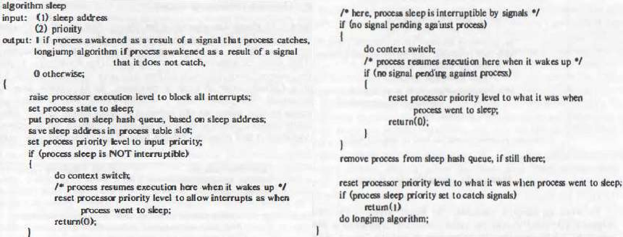
Sleep

Slide 23
Steps of sleep() algorithm
Kernel first raises the process execution level to block all interrupts.
Marks the state of process as “ASLEEP” and makes appropriate entry in process table.
Kernel maintains a hash queue of currently slept process. So kernel keeps this newly process on the hash queue.
Kernel saves the “sleep address” in process table and also sets and saves the process priority level to “input priority” allows the process to catch signals if process’s sleep is going to be interruptible by signals.
If process’s sleep state is not interruptible by any signals.
In such case process is going to sleep and hence “Context switch” is allowed.
So kernel saves context layer of this process (by setjmp) and does a context switch to start context layer of another, scheduled process.
Now process safely sleeps and when awakes enter in to ready to run state.
After coming back to sleep algorithm kernel restores process previous execution level to allow usual interrupts and returns 0 as its
exit status of sleep algorithm.
6. If process’s sleep state is interruptible .Kernel always check for pending signals for this sleeping process.
If no signals is pending for the process then..
So kernel saves context layer of this process (by setjmp) and does a context switch to start context layer of another, scheduled process.
Now process safely sleeps and when awakes enter in to ready to run state.
After coming back to sleep algorithm kernel again checks for pending signals .If still signals are not pending for the process then….
restores process previous execution level to allow usual interrupts and returns 0 as its exit status of sleep algorithm.
7. If process’s sleep state is interruptible .Kernel always check for pending signals for this sleeping process.
If signal is pending for the process then..
if “priority” is set above the threshold then process will not think about the signal and will wake up only when required event occurs. So it will wakeup by kernel with explicit wakeup call.
But if “sleep priority” is below the “threshold” then process actually does not go to sleep but respond the arrived signals as if it is sleeping

Slide 24
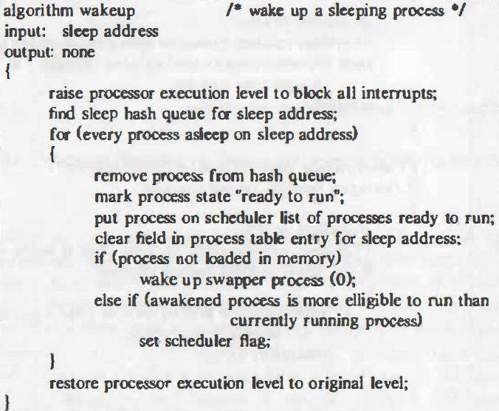
Wakeup Algorithm
To wake up sleeping processes, the kernel executes the wakeup algorithm, either during the usual system call algorithms or when handling an interrupt.
For instance, the algorithm iput releases a locked inode and awakens all processes waiting for the lock to become free.
Similarly, the disk interrupt handler awakens a process waiting for I/O completion. The kernel raises the processor execution level in wakeup to block out interrupts.

Slide 25
Locks (i.e., spinlocks) in xv6 are implemented using the xchg atomic instruction. The function to acquire a lock disables all interrupts, and the function that releases the lock re-enables them.
1500 // Mutual exclusion lock.
1501 struct spinlock {
1502 uint locked; // Is the lock held?
1503
1504 // For debugging:
1505 char *name; // Name of lock.
1506 struct cpu *cpu; // The cpu holding the lock.
1507 uint pcs[10]; // The call stack (an array of program counters)
1508 // that locked the lock.
1509 };
spinlocks are declared in kern/spinlock.h, and support the following four operations:
void spinlock_init(spinlock *lk): initialize spinlock lk to the unlocked state.
void spinlock_acquire(spinlock *lk): acquire spinlock lk, spinning if necessary until it becomes available.
void spinlock_release(spinlock *lk): release spinlock lk.
int spinlock_holding(spinlock *lk): return true (nonzero) if this CPU is holding spinlock lk, false (zero) otherwise.
pushcli :Disables interrupts, Increments a "nested call count", Remembers whether interrupts were originally enabled when ncli was 0
Popcli: Decrements nested call count. If now zero, enables interrupts if they were originally enabled.
0379 // spinlock.c
0380 void acquire(struct spinlock*);
0381 void getcallerpcs(void*, uint*);
0382 int holding(struct spinlock*);
0383 void initlock(struct spinlock*, char*);
0384 void release(struct spinlock*);
0385 void pushcli(void);
0386 void popcli(void);

Slide 26
So, let us look at how the acquire function is implemented in so let us look at xv6 locks all
right. So, let us look at how xv6 is implementing locks. That is the lock function, that is the acquire function basically, let see what the lock structure is before that. So, lock structure you know if you want to initialize a lock you basically have three fields in the lock one is the name, name is just for debugging purposes Then there is this lock variable that we know about that is the state of the lock and then also which CPU is holding it that is also again only for debugging.
So, In the acquire function, pushcli is going to disable the interrupts on the current processor. So, notice that the acquire function disables interrupts uses this loop to atomically set the locked variable to 1, sets the CPU to the current CPU value and the this is some debugging function which allows you to log exactly who called this lock and that is it.
So, what does it mean, when you get out of acquire this interrupts as still disabled right, because you called pushcli and you never called pop right you never enable re enabled interrupts. So, for the entire critical section in this spin lock the interrupts are disabled. So, why does xv6 need to disable interrupts in the entire critical section?

Slide 27
So, basically to protect a thread from the interrupt handler from concurrent accesses by the interrupt handler, you disable the interrupts for the entire critical section. And acquire leaves the interrupts disabled.
So, notice that this holding function what is it doing it just checking that whether I am holding the lock already, whether this CPU is holding the lock already.
So, this is the release function and once again there is just debugging aid which is if not holding lock then you know you panic that you trying to release a lock that you not holding that is fine and you set cpu to 0 and then you exchange lock with 0. So, once again why do I need an exchange it, so I could have just set lock dot lock l k dot locked is equal to 0. But instead the programmer chooses to use the exchange instruction to do this why

Slide 28
1550 // Mutual exclusion spin locks. 1551 1552 #include "types.h" 1553 #include "defs.h" 1554 #include "param.h" 1555 #include "x86.h" 1556 #include "memlayout.h" 1557 #include "mmu.h" 1558 #include "proc.h" 1559 #include "spinlock.h" 1560 1561 void 1562 initlock(struct spinlock *lk, char *name) 1563 { 1564 lk−>name = name; 1565 lk−>locked = 0; 1566 lk−>cpu = 0; 1567 } 1568
1569 // Acquire the lock.
1570 // Loops (spins) until the lock is acquired.
1571 // Holding a lock for a long time may cause
1572 // other CPUs to waste time spinning to acquire it.
1573 void
1574 acquire(struct spinlock *lk)
1575 {
1576 pushcli(); // disable interrupts to avoid deadlock.
1577 if(holding(lk))
1578 panic("acquire");
1579
1580 // The xchg is atomic.
1581 while(xchg(&lk−>locked, 1) != 0)
1582 ;
1583
1584 // Tell the C compiler and the processor to not move loads or stores
1585 // past this point, to ensure that the critical section’s memory
1586 // references happen after the lock is acquired.
1587 __sync_synchronize();
1588
1589 // Record info about lock acquisition for debugging.
1590 lk−>cpu = mycpu();
1591 getcallerpcs(&lk, lk−>pcs);
1592 }
So, let us look at how the acquire function is implemented in.. So, let us look at how xv6 is implementing locks.

Slide 29
1600 // Release the lock.
1601 void
1602 release(struct spinlock *lk)
1603 {
1604 if(!holding(lk))
1605 panic("release");
1606
1607 lk−>pcs[0] = 0;
1608 lk−>cpu = 0;
1609
1610 // Tell the C compiler and the processor to not move loads or stores
1611 // past this point, to ensure that all the stores in the critical
1612 // section are visible to other cores before the lock is released.
1613 // Both the C compiler and the hardware may re−order loads and
1614 // stores; __sync_synchronize() tells them both not to.
1615 __sync_synchronize();
1616
1617 // Release the lock, equivalent to lk−>locked = 0.
1618 // This code can’t use a C assignment, since it might
1619 // not be atomic. A real OS would use C atomics here.
1620 asm volatile("movl $0, %0" : "+m" (lk−>locked) : );
1621
1622 popcli();
1623 }

Slide 30
1662 // Pushcli/popcli are like cli/sti except that they are matched:
1663 // it takes two popcli to undo two pushcli. Also, if interrupts
1664 // are off, then pushcli, popcli leaves them off.
1665
1666 void
1667 pushcli(void)
1668 {
1669 int eflags;
1670
1671 eflags = readeflags();
1672 cli();
1673 if(mycpu()−>ncli == 0)
1674 mycpu()−>intena = eflags & FL_IF;
1675 mycpu()−>ncli += 1;
1676 }
1677
1678 void
1679 popcli(void)
1680 {
1681 if(readeflags()&FL_IF)
1682 panic("popcli − interruptible");
1683 if(−−mycpu()−>ncli < 0)
1684 panic("popcli");
1685 if(mycpu()−>ncli == 0 && mycpu()−>intena)
1686 sti();
1687 }
1650 // Check whether this cpu is holding the lock.
1651 int
1652 holding(struct spinlock *lock)
1653 {
1654 int r;
1655 pushcli();
1656 r = lock−>locked && lock−>cpu == mycpu();
1657 popcli();
1658 return r;
1659 }
1660
1661

Slide 31
2884 // Must acquire ptable.lock in order to
2885 // change p−>state and then call sched.
2886 // Once we hold ptable.lock, we can be
2887 // guaranteed that we won’t miss any wakeup
2888 // (wakeup runs with ptable.lock locked),
2889 // so it’s okay to release lk.
2890 if(lk != &ptable.lock){
2891 acquire(&ptable.lock);
2892 release(lk);
2893 }
2894 // Go to sleep.
2895 p−>chan = chan;
2896 p−>state = SLEEPING;
2897
2898 sched();
2899
2900 // Tidy up.
2901 p−>chan = 0;
2902
2903 // Reacquire original lock.
2904 if(lk != &ptable.lock){
2905 release(&ptable.lock);
2906 acquire(lk);
2907 }
2908 }
2871 // Atomically release lock and sleep on chan.
2872 // Reacquires lock when awakened.
2873 void
2874 sleep(void *chan, struct spinlock *lk)
2875 {
2876 struct proc *p = myproc();
2877
2878 if(p == 0)
2879 panic("sleep");
2880
2881 if(lk == 0)
2882 panic("sleep without lk");
2883

Slide 32
2950 // Wake up all processes sleeping on chan.
2951 // The ptable lock must be held.
2952 static void
2953 wakeup1(void *chan)
2954 {
2955 struct proc *p;
2956
2957 for(p = ptable.proc; p < &ptable.proc[NPROC]; p++)
2958 if(p−>state == SLEEPING && p−>chan == chan)
2959 p−>state = RUNNABLE;
2960 }
2961
2962 // Wake up all processes sleeping on chan.
2963 void
2964 wakeup(void *chan)
2965 {
2966 acquire(&ptable.lock);
2967 wakeup1(chan);
2968 release(&ptable.lock);
2969 }

Slide 33
Thank You

